Slide 1


CYBR644 – Cyber Practitioner Lab
Spring 2024
University of Maryland, Baltimore County
Michael Hennick

Slide 2
Overview of the course
Week 01 – Introduction, Ethical Hacking Basics, Ethics, Law
Week 02 – Technical Foundations of Hacking
Week 03 – Reconnaissance, Social Media
Week 04 – Scanning and Probing
Week 05 – Vulnerability Identification
Week 06 – Exploiting Weaknesses
Week 07 – Class Presentations / Review for Exam
Week 08 – Spring Break
Week 09 – Midterm Exam
Week 10 – Privilege Escalation, Maintaining Access
Week 11 – Malware, Covering your Tracks
Week 12 – The Web
Week 13 – Wireless and Mobile Security
Week 14 – Physical Security, Social Engineering, and Security Policies
Week 15 – Class Presentations / Review for Exam
Week 16 – Final Exam

Slide 3
Review
Know the six steps in the attacker’s methodology.
Explain the ethical hacker’s process.
Be familiar with the OSI model and each layer’s function.
Be familiar with the TCP/IP protocol stack.
Describe the four layers in the TCP/IP protocol.

Slide 4
Attacker’s Methodology
Attackers follow a fixed methodology that can be divided into six steps:
Performing reconnaissance
Scanning and enumeration
Gaining access
Escalation of privilege
Maintaining access
Covering tracks and placing backdoors

Slide 5
Reconnaissance and Footprinting
The first pre-attack phase
Systematic attempt to collect as much information about the target as possible:
PASSIVE information gathering
Reconnaissance techniques:
Dumpster diving
Social engineering
Internet research
What network space does a target use?
What does the internet know about a target?
What information about my target is in social media sites?

Slide 6
Information Gathering
Potential sources of information:
Company website
Domain names, internal domains, employees emails and phone numbers
Wayback Machine for archived web pages
Job boards and employees job ads
Can provide info about software and hardware systems the company uses
Employee and people searches
Social networking sites
EDGAR database
Google hacking
USENET
Registrar query – whois searches
DNS enumeration – nslookup tool

Slide 7
What is Reconnaissance?
Dictionary definition:
1. Military observation of a region to locate an enemy or ascertain strategic features.
2. Preliminary surveying or research
Low Tech Recon
Visiting Target
Breaking into Target
Dumpster Diving
Social Engineering
Technical Recon
Social Engineering
Registration Information
Open Source Intelligence
Social Media

Slide 8

Low Tech Reconnaissance
Breaking In
Visiting without authority ☺
Visit Target
Security guards, walls, fencing, door locks, badge access, lobby area, cafeteria, etc
Dumpster Diving
Network diagrams, telephone lists, temporary passwords, vendor receipts, organization chart, random notes, etc…

Slide 9

Low Tech/tech Reconnaissance
Social Engineering
“Act of manipulating people into performing actions or divulging confidential information, rather than breaking in or using technical cracking techniques” ~ Wikipedia
“Most malware and client-side attacks have a social engineering component to deceive the use into letting the bad guys in. You can patch technical vulnerabilities as they evolve, but there is not patch for stupidity, or rather gullibility.” ~ Kevin Mitnick

Slide 10

Social Engineering
Job Requisitions/Recruiter
Apply to job openings at target
Cold-call employees offering jobs
Vendor Research
What technology needs does the target have?
Phone phishing
Spoofing caller-ID
Baiting
USB/CD/DVD
Email phishing
Spoofing email addresses

Slide 11
Registration Information
Domain Name registration
Any administrative information on the target?
Points of contact?
Domain expiration date?
GEO IP Information
Where is the target’s network located?
ISP Records
What provider network does the target use?
DNS Records
What other systems can I find out about?
Hosting Information
What environment is the target server in?

Slide 12
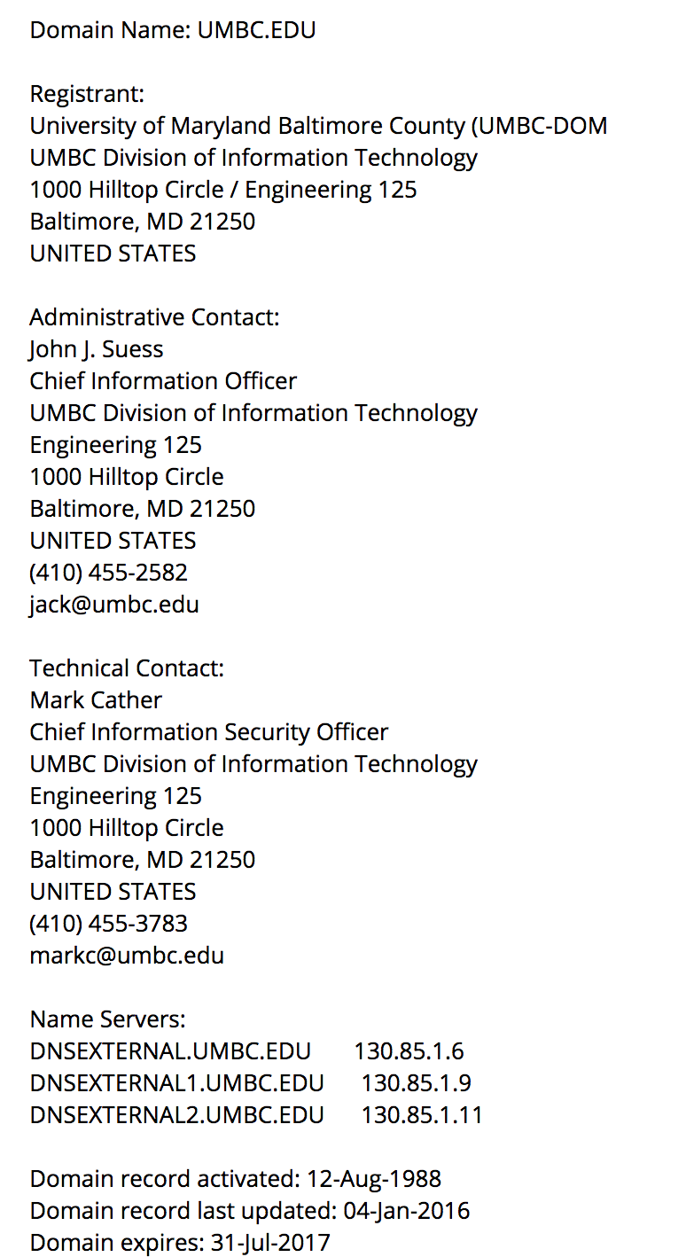
Domain Name Registration
WHOIS search of target (Classic)
RDAP – Registration Data Access Protocol (New)

Slide 13
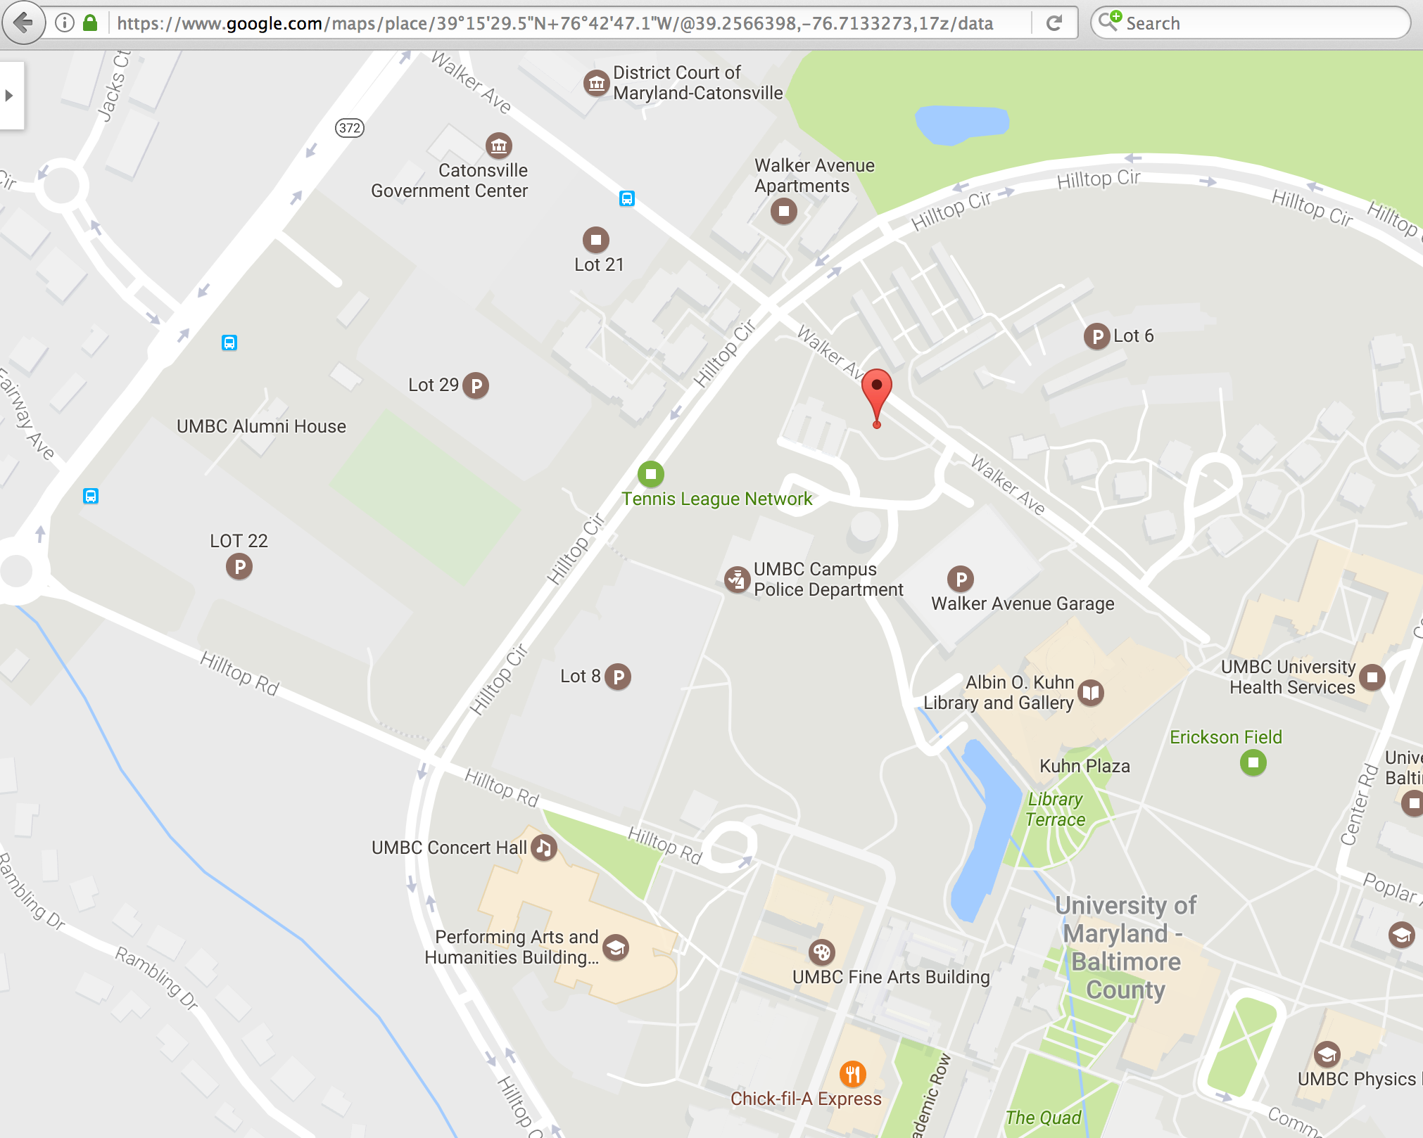
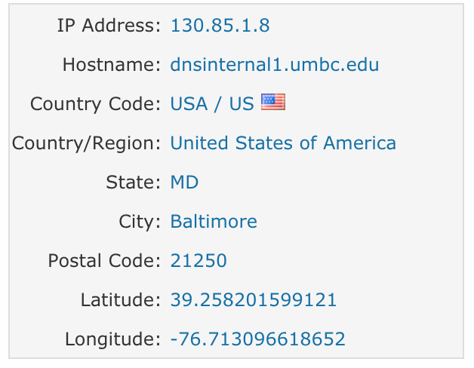
GEO-Location
Geolocation of target

Slide 14
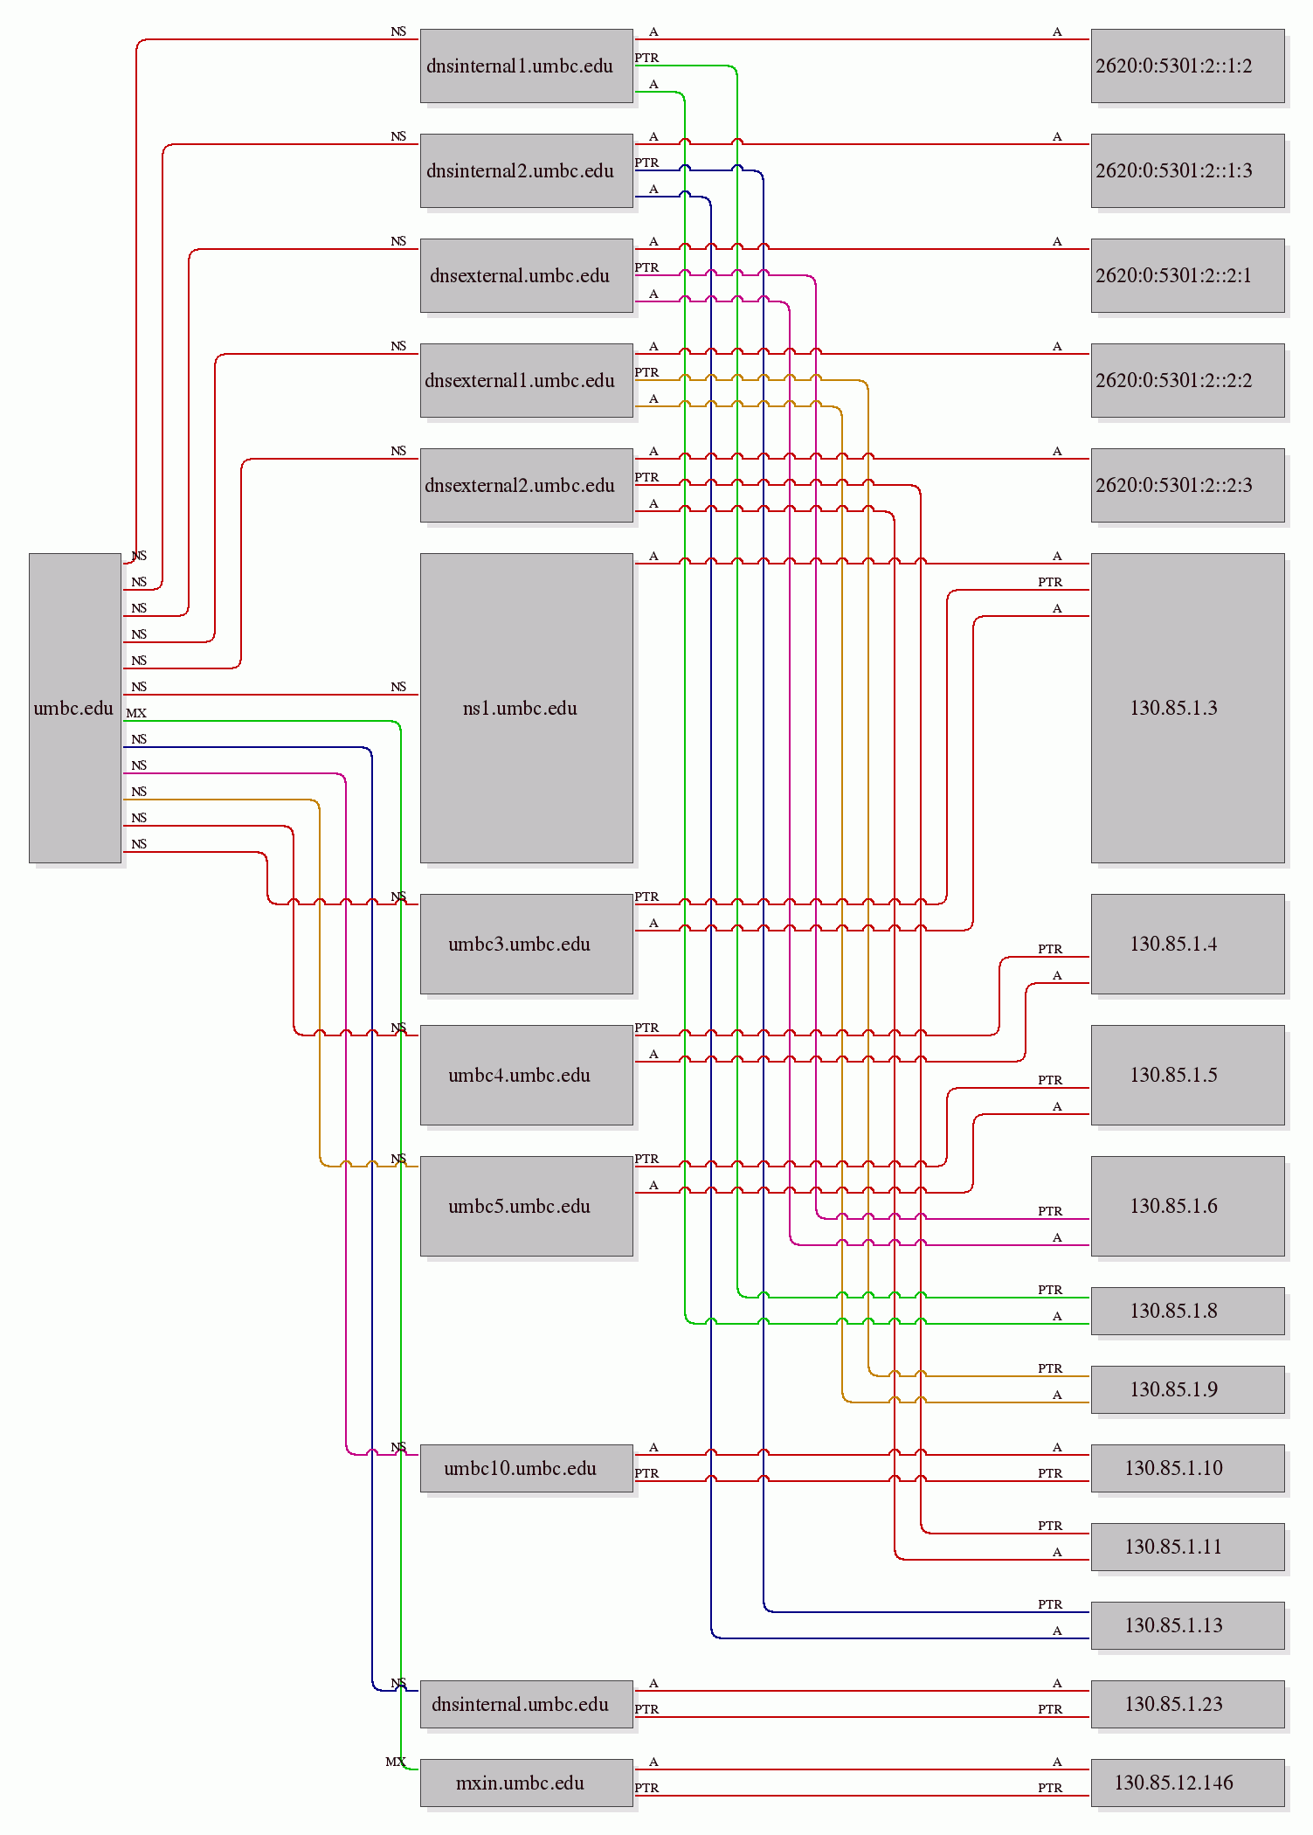
DNS/ISP Information
DNS records of target

Slide 15
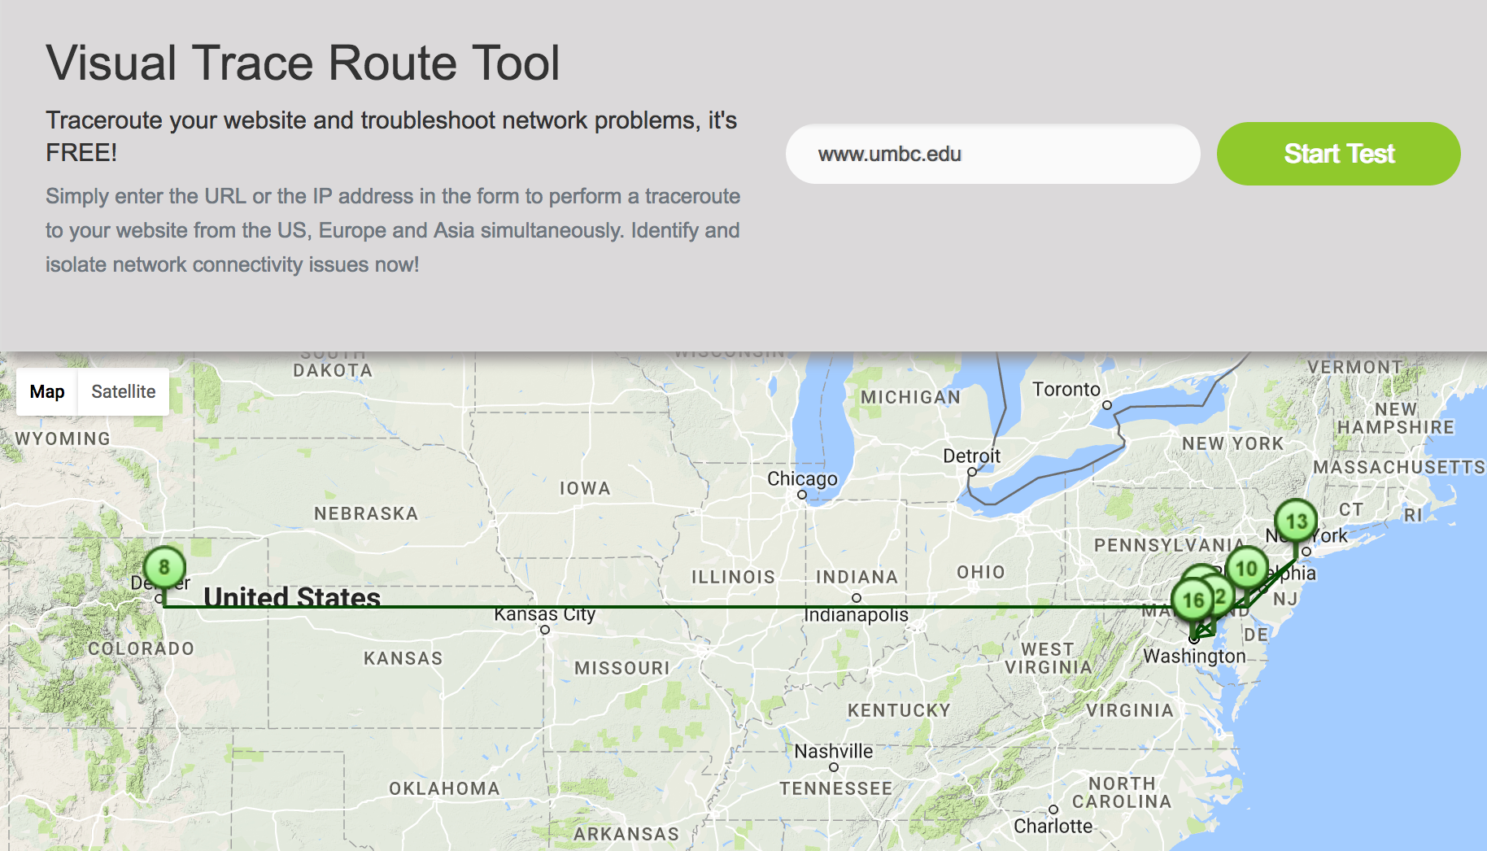
Visual Traceroute
Visual Trace between you and target

Slide 16
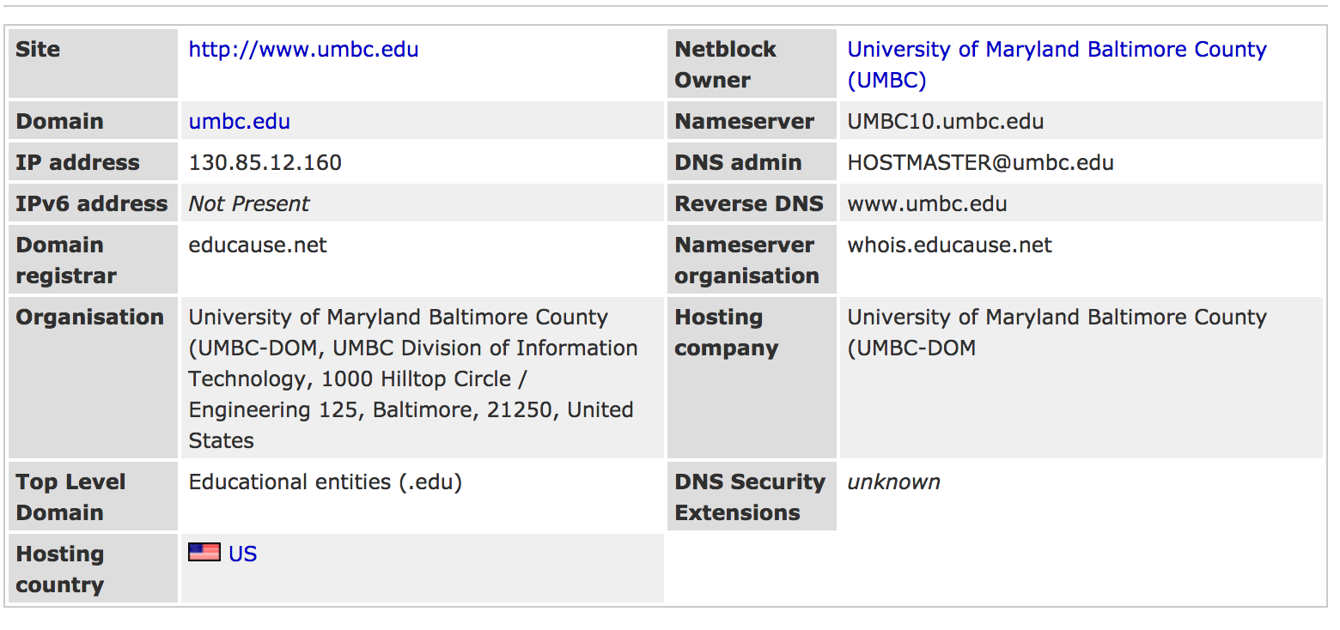
Hosting Information
Environment, Network space, etc

Slide 17
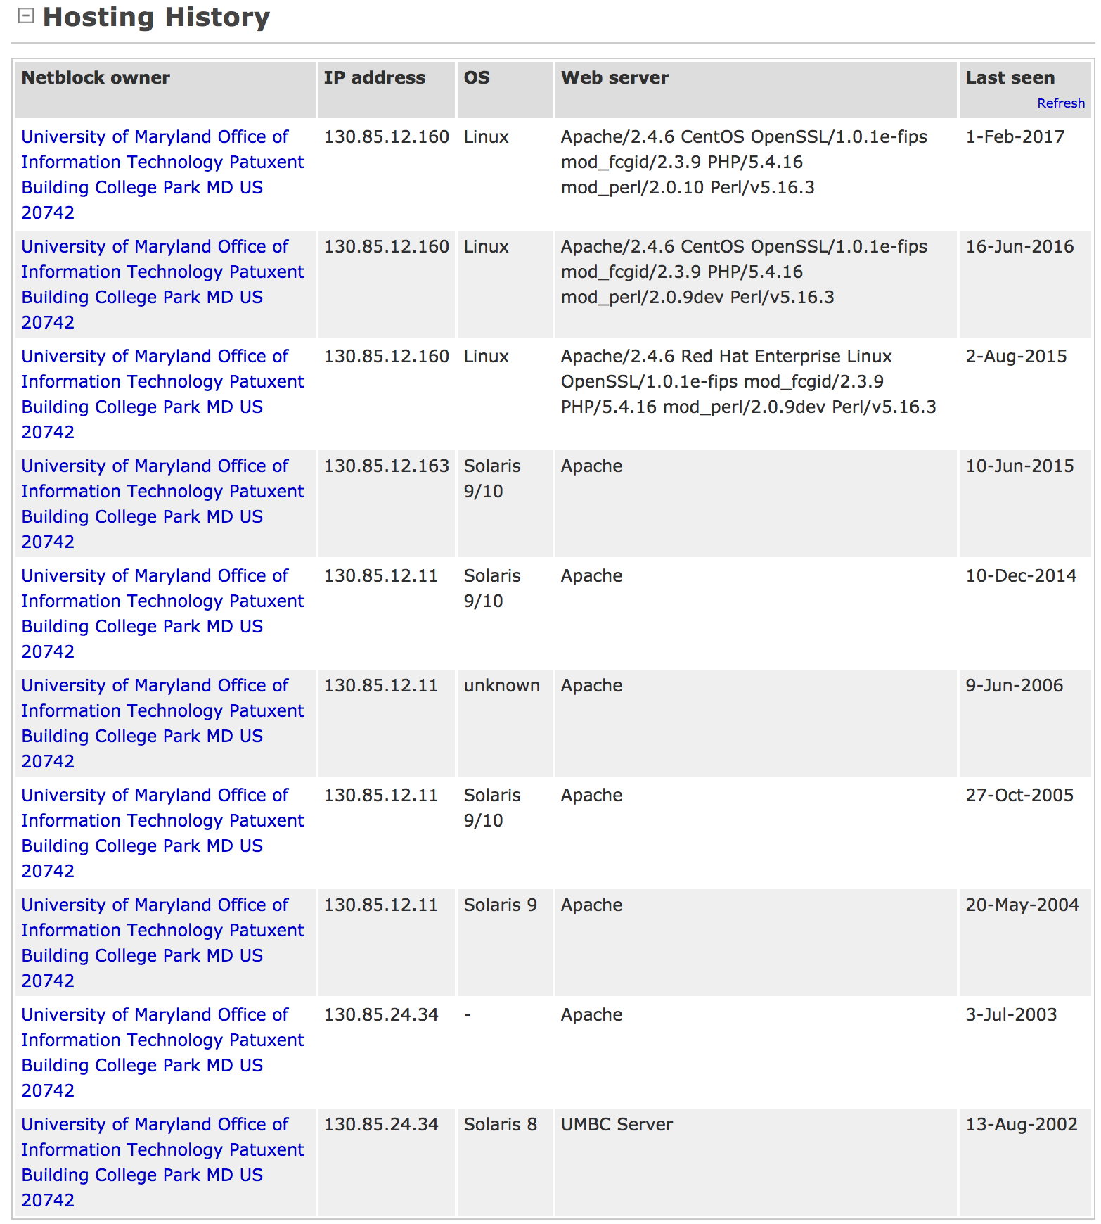
Hosting Information
Environment, Network space,
etc continued

Slide 18
ViewDNS.INFO
One Stop Shopping!
DNS, Whois, IP, ASN, and more!

Slide 19
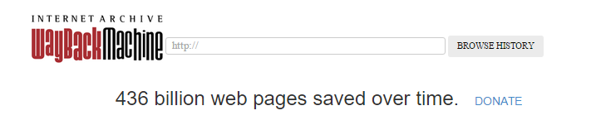
Wayback Machine
Archive of internet websites – available for review for previous information, old press releases, data thought to have been “removed”
https://archive.org/

Slide 20




Job Postings

Slide 21
Open Source Intelligence
Google – search for information meeting a specific criteria
Search on target
Search on error code
Google hacking
Bing – search for information meeting a specific criteria
IP address co-location
Shodan - search for systems on the internet meeting a specific criteria
OS version
Application Version
Specific model

Slide 22
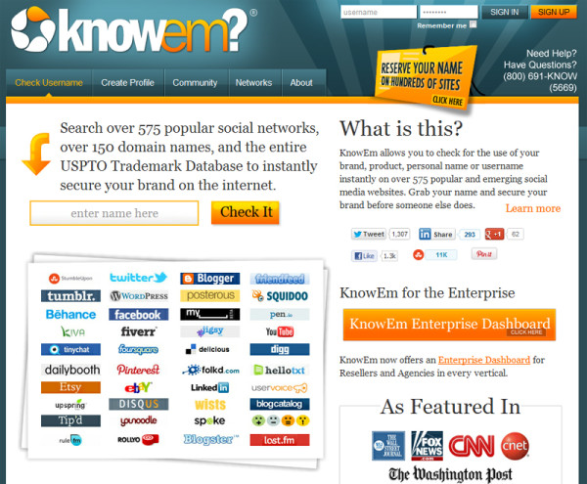
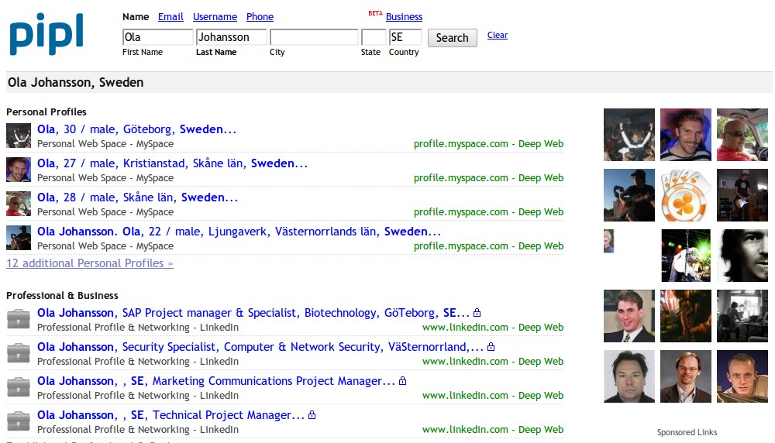
Open Source Intelligence
Name Searches:
Knowem.com
Namchk.com
Aggregators:
Pipl.com
Radaris.com
Thatthem.com
Zabasearch.com
Familytreenow.com

Slide 23
Google
Simple Searching
Target name
Press Releases
Website
References
Error Code
Servers potentially vulnerable
SQL errors
PHP errors
HTTP response codes
Advanced searching
Google Alerts triggers

Slide 24
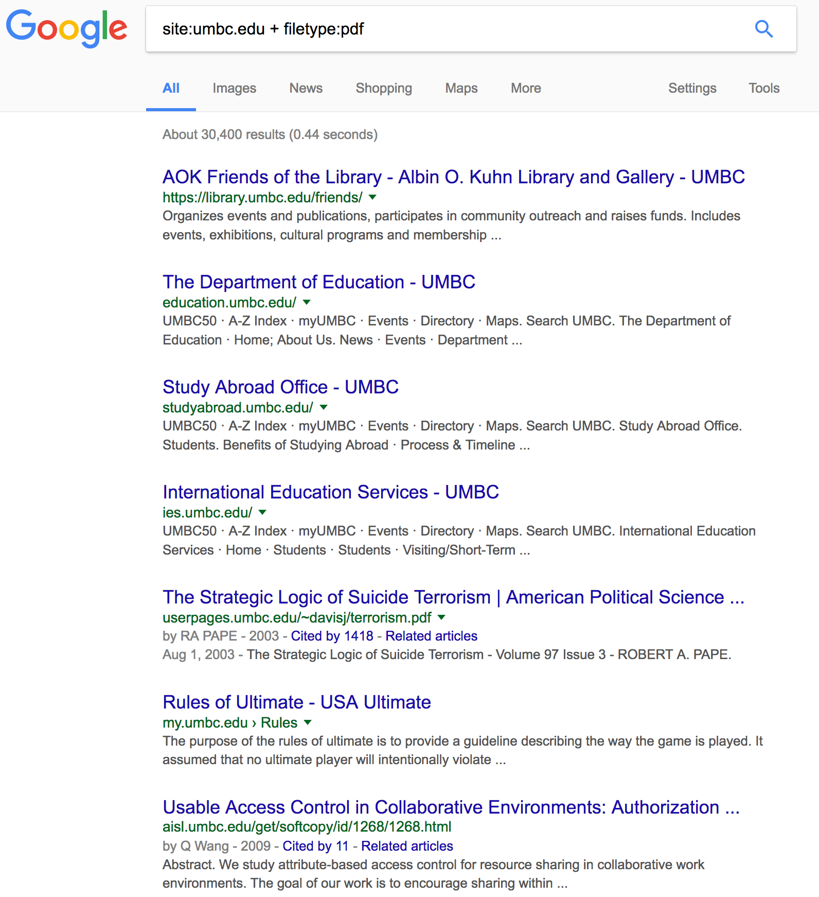
Google
Google Hacking
intitle:
intext:
filetype:
site:
inurl:

Slide 25
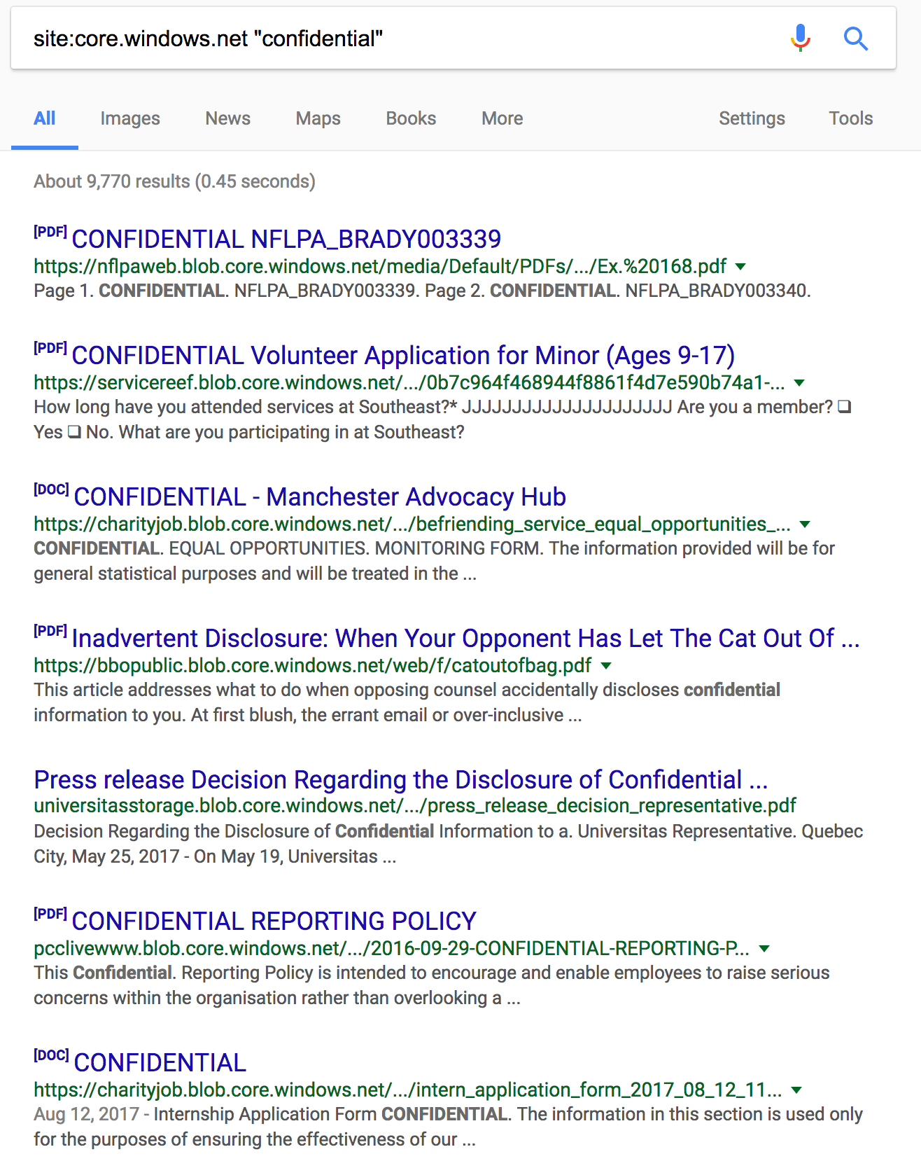
Google
Microsoft Office Documents Storage;
All “public” documents can be indexed
by search engines….

Slide 26
Google
Examples:
inurl:indexFrame.shtml – AXIS Cameras
site:umbc.edu + filetype:pdf – all PDFs within umbc.edu domain sites
intitle:”index of” - Directory Browsing enabled
filetype:log + intext:password – log files containing mention of passwords
inurl:tsweb – Terminal Services Web site
inurl:”robots.txt” – websites with a robots.txt file
Many more “google dorks” available – See the GHDB:
https://www.exploit-db.com/google-hacking-database

Slide 27
Robots.txt
Tells a search engine spider or crawler what it can index
Some administrators use as a form of security
User-agent: *
Disallow: [some path or filename]
Examples:
www.umbc.edu/robots.txt
www.facebook.com/robots.txt
www.whitehouse.gov/robots.txt

Slide 28
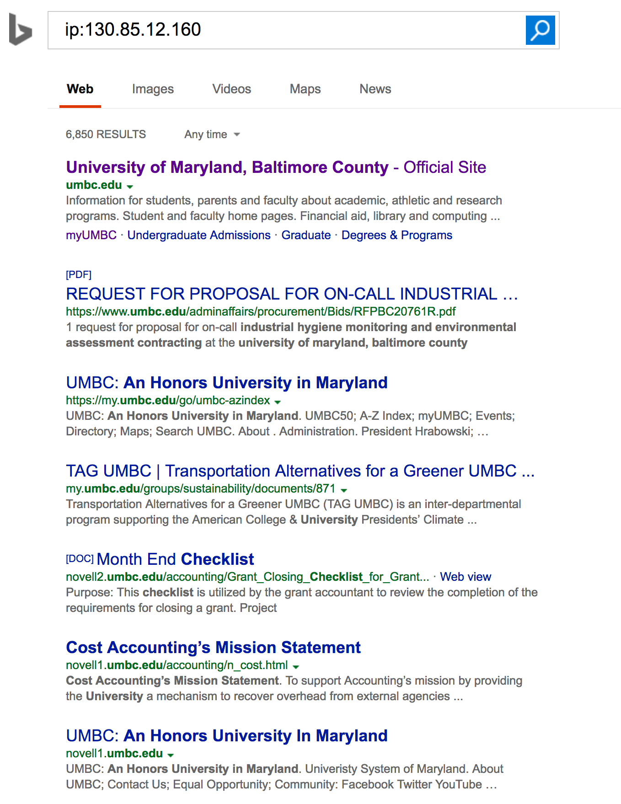
Bing
Bing IP search operand
“IP: [ip address]”

Slide 29
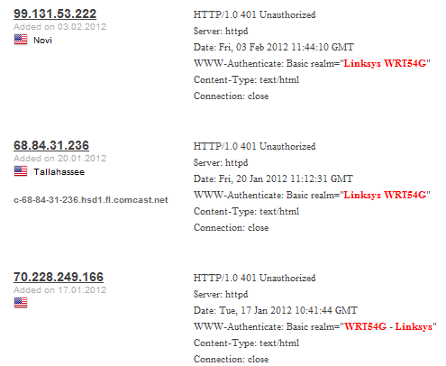
Shodan
www.shodan.io
Search for systems of type _____
IIS version A
PHP/X.Y.Z
Windows NT/#.0
SCADA
LINKSYS Router model WRT54G
etc

Slide 30
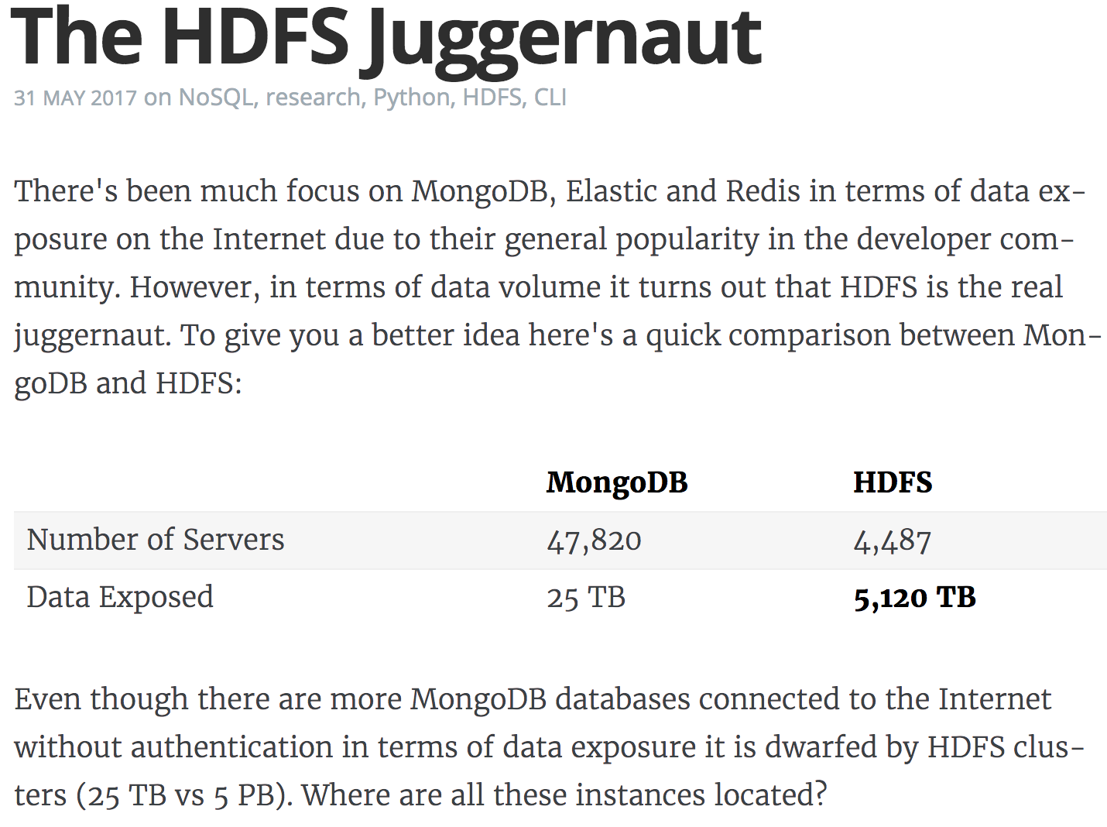
Shodan
https://blog.shodan.io/the-hdfs-juggernaut/

Slide 31
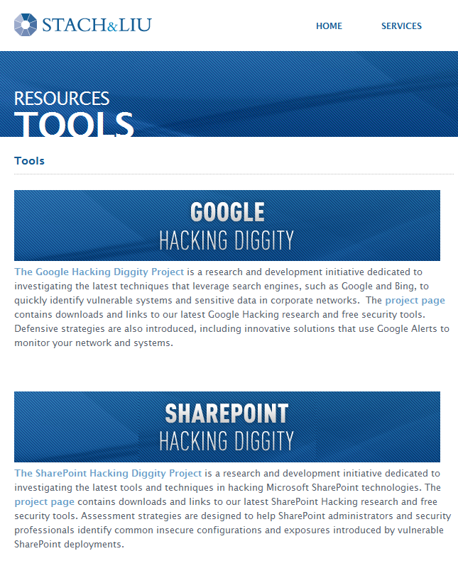

Automated Tools
Stach & Liu
GoogleDiggity
BingDiggity
MalwareDiggity
Search Diggity
Paterva
Maltego

Slide 32
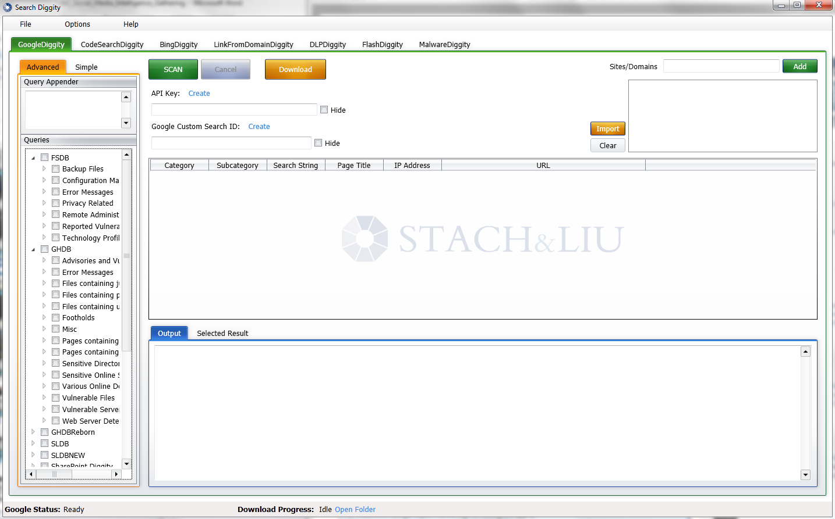
SearchDiggity

Slide 33
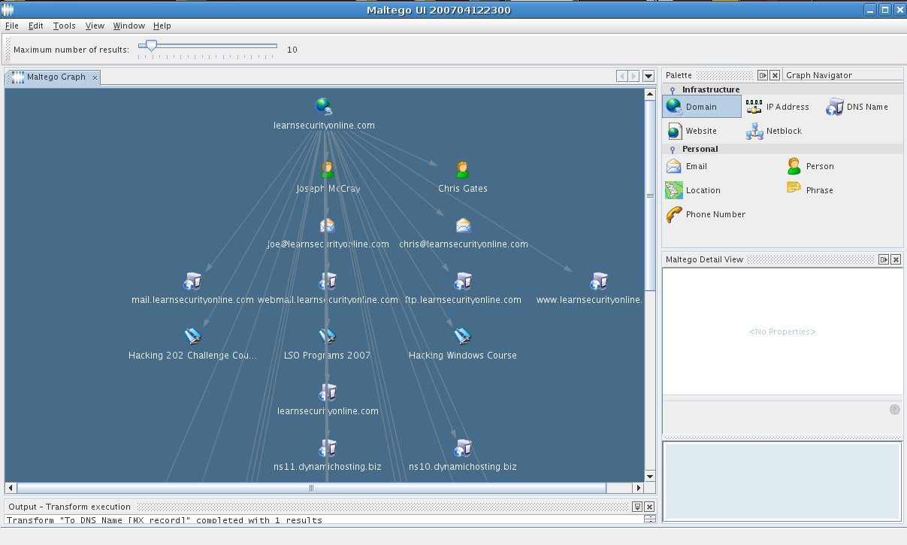
Maltego

Slide 34

Break

Slide 35
What is Social Media?
“Social media includes web-based and mobile technologies used to turn communication into interactive dialogue” ~Wikipedia
Allow people to network, interact and collaborate to share information, data and ideas without geographic boundaries
Social Networking Sites
(Facebook, Google+, Twitter, My____, LinkedIn, etc)
Communications/Email
(LiveJournal, Wordpress, Drupal, Eventful, etc)
Collaboration/Authoring
(Joomla, Drupal, Dropbox, Wikis, etc)
Multimedia
(Youtube, ustream,flickr, photobucket, etc)
Reviews
(Yelp, epinions, etc)

Slide 36
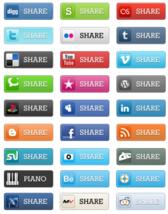
Why use Social Media?
Personally
Entertaining
Maintain Relationships
Network
Centralized information
Professionally
Marketing/recruiting
Public Relations
Connect with customers
Solicit ideas and feedback

Slide 37

Why use Social Media?
Attackers use it too:
Stalkers
Thieves
Terrorists
Hackers
Phishers/Scammers
Enemy organizations
Pedophiles
And the list goes on…

Slide 38
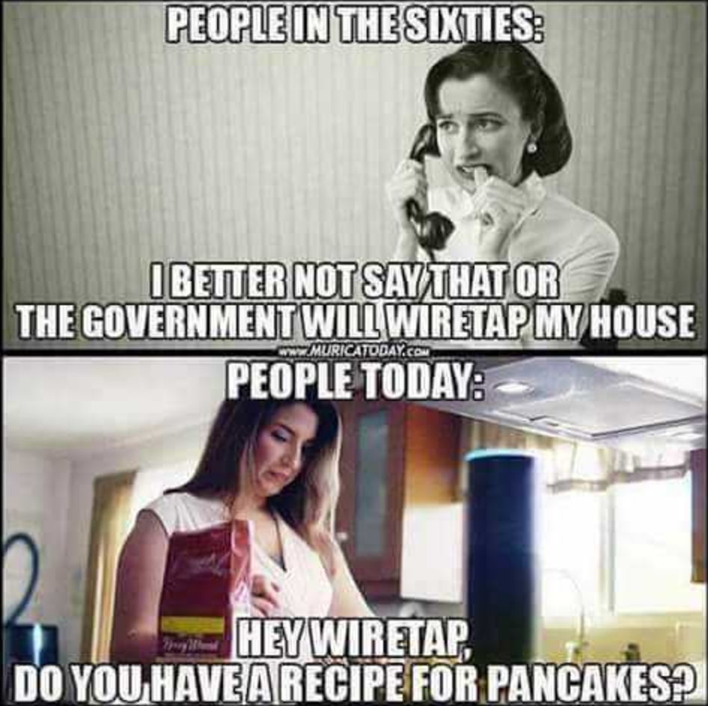
Social Media Security
Prerequisites:
- Self Control
- Secure Passwords
Areas of concern:
- Integration with other applications
- Single Sign On to cloud services
- Automated data sharing/backups
- Mobile Devices & “Apps”
- Increased performance and processing power

Slide 39
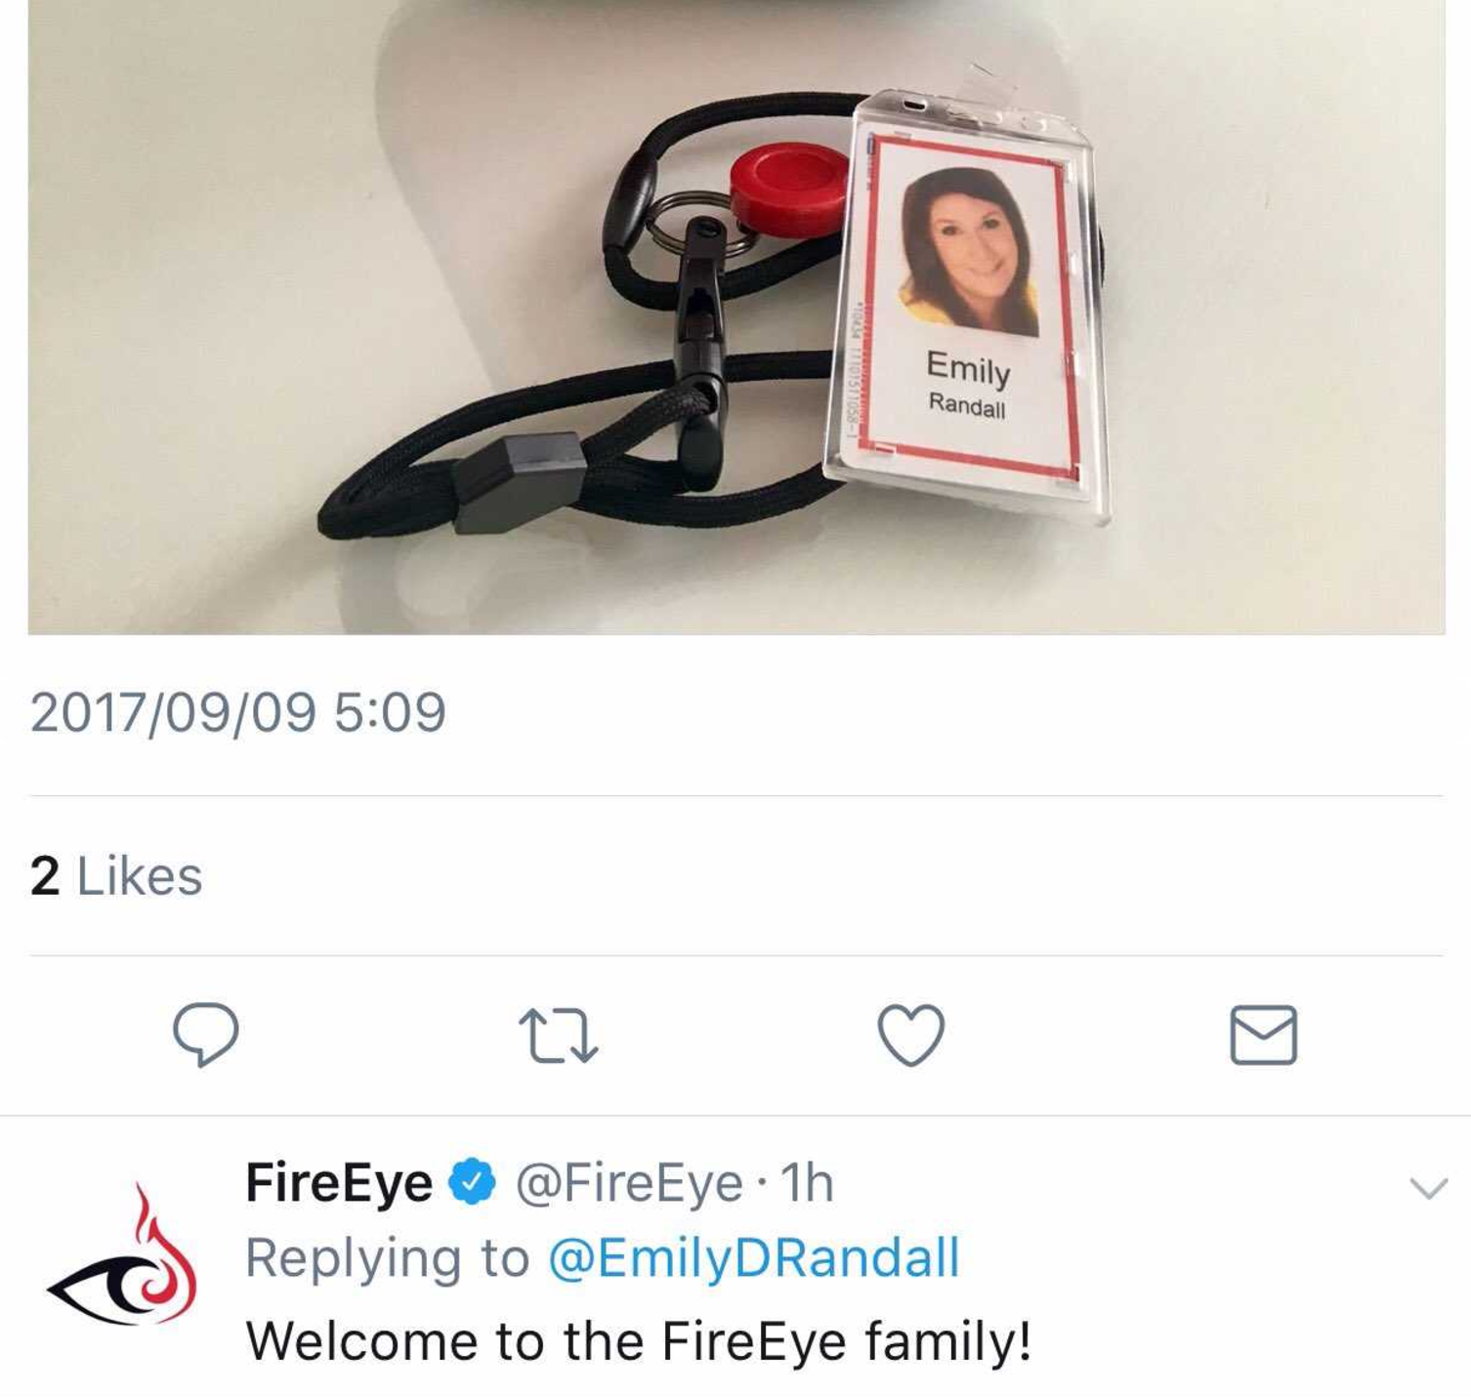
Share!
Share an article with friends that you find interesting
Sometimes without you even trying
Share your disdain for your work environment
Is your co-worker a “friend”?
Share what you are doing right now
And where!
Collaborate with others
To start a revolution
Spreading the word about emergencies
Amber Alerts
Disasters

Slide 40

Too much Sharing?
- Travel Itinerary
- Details about your job
- Wishes/Desires
- Full arguments with others via “Wall” posting
- Photos of family with captions of everyone’s names
- Customized advertisements based on browsing history
- Customized advertisements based on content in your email box
- Automatic Geo-tagging of photos uploaded via smartphones
- Automatic sharing with friends of what new articles you are reading

Slide 41
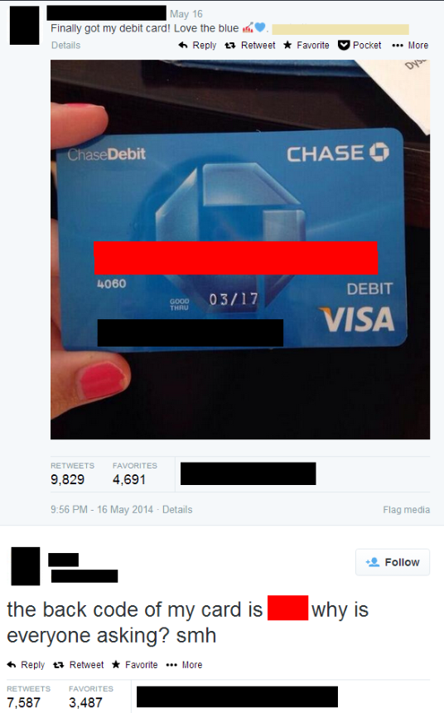
Too much Sharing?

Slide 42
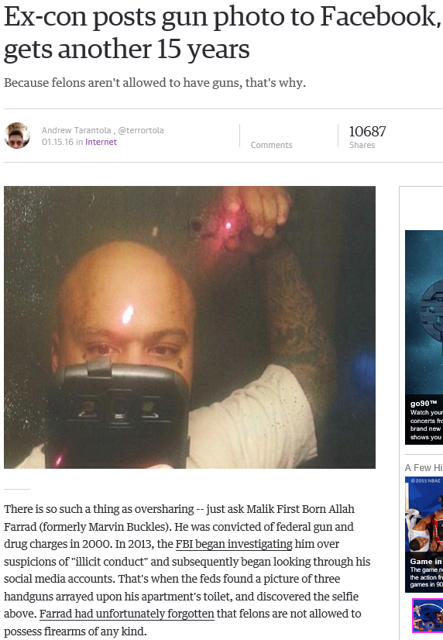
Too much Sharing?

Slide 43
Good/Bad Social Networking
https://www.youtube.com/watch?v=_YRs28yBYuI
https://www.youtube.com/watch?v=F7pYHN9iC9I

Slide 44
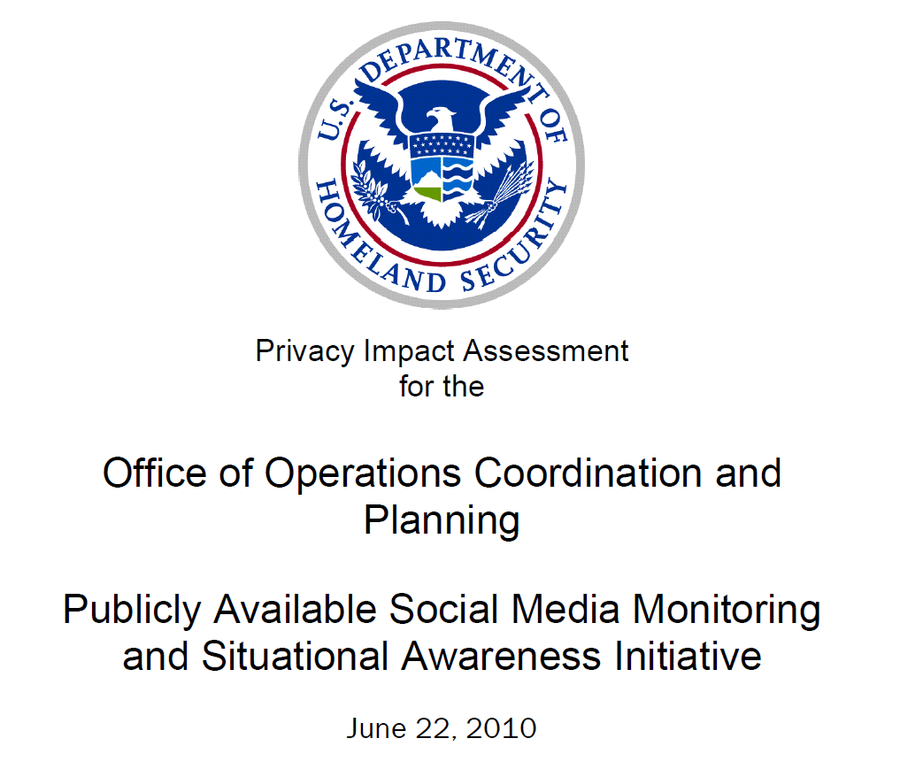
Social Media Monitoring
https://www.dhs.gov/publication/dhs-ops-pia-004f-publicly-available-social-media-monitoring-and-situational-awareness

Slide 45
Social Media Data Mining
Tools to perform searches against Social Networking Sites
Google
Bing
Automated tools?
- The Harvester
python based script to perform simple queries
- Recon-ng
python based application for information gathering
- Spiderfoot
CLI and web based automation platform for Recon and OSINT

Slide 46
The Harvester
Command line search tool to perform Open Source Intelligence Collection
Search for email accounts for the domain microsoft.com, harvesting from the first 500 google results:
theharvester -d microsoft.com -l 500 -b google
Searching emails accounts for the domain microsoft.com in a PGP server:
theharvester -d microsoft.com -b pgp
Searching for user names that work in the company Microsoft via linkedin, with a limit of 200 results:
theharvester -d microsoft.com -l 200 -b linkedin
Searching in all sources at the same time, with a limit of 200 results:
theHarvester -d microsoft.com -l 200 -b all

Slide 47
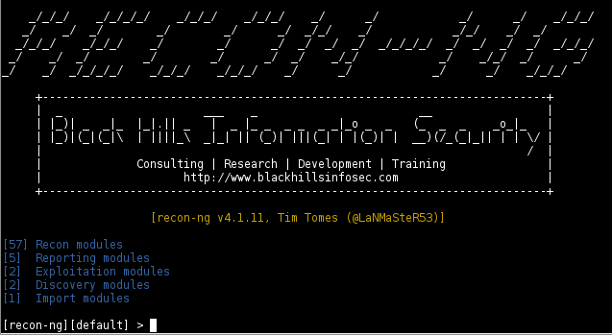
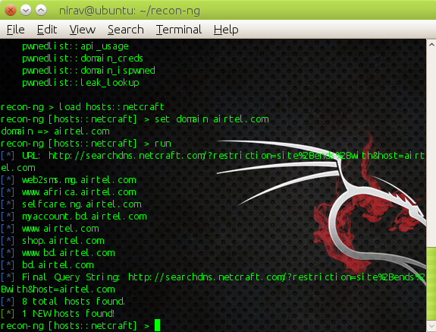
RECON-NG
https://bitbucket.org/LaNMaSteR53/recon-ng/wiki/Usage%20Guide

Slide 48
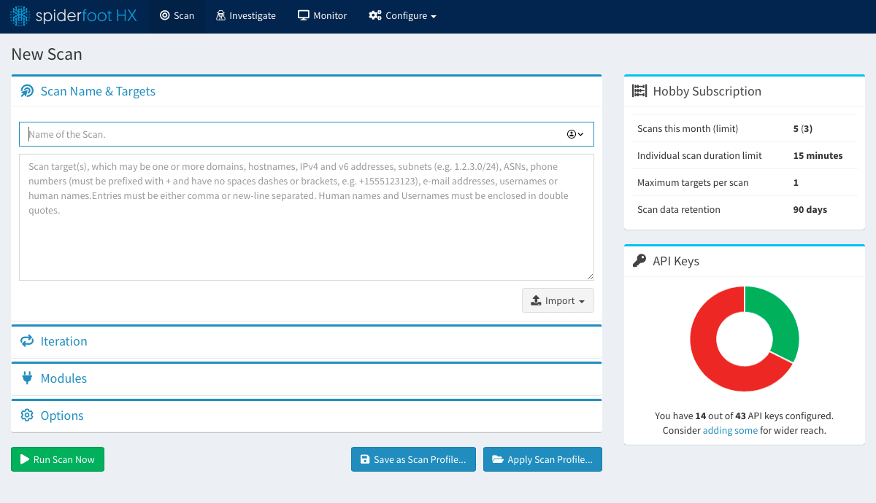
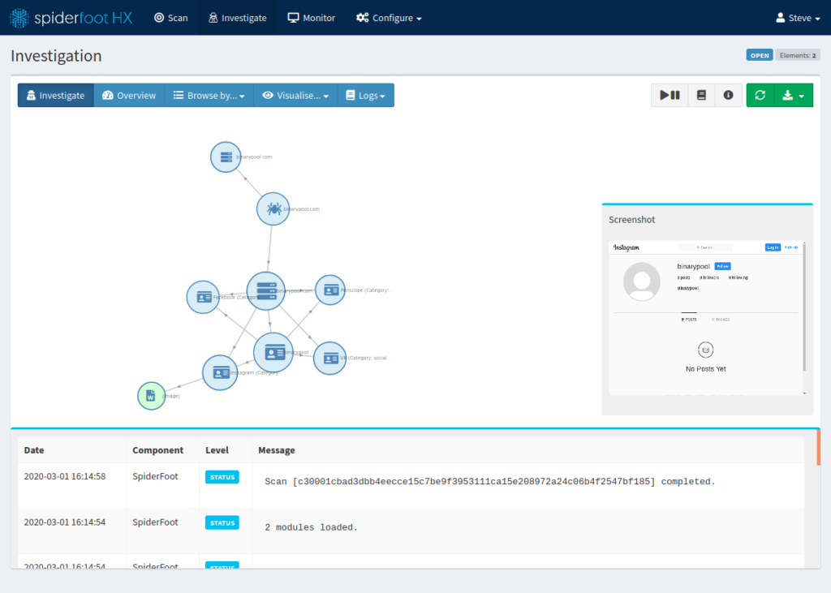
Spiderfoot
Automatically queries over 100 public data sources to gather intelligence on IP addresses, domain names, e-mail addresses, names and more

Slide 49
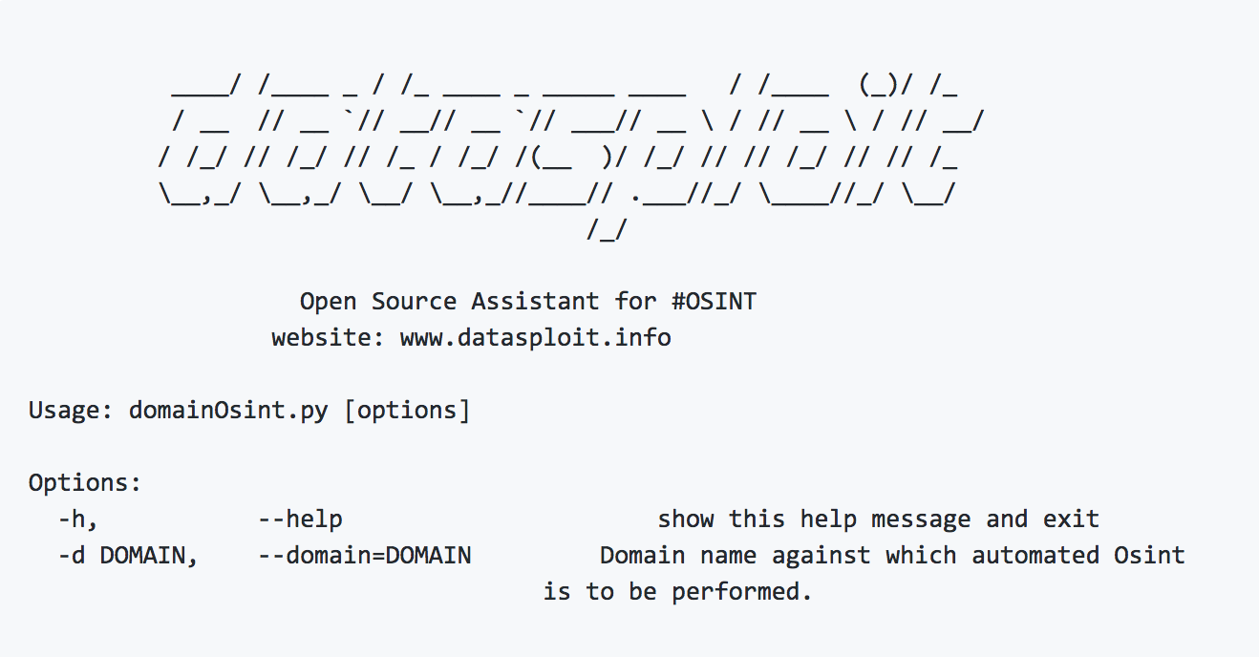

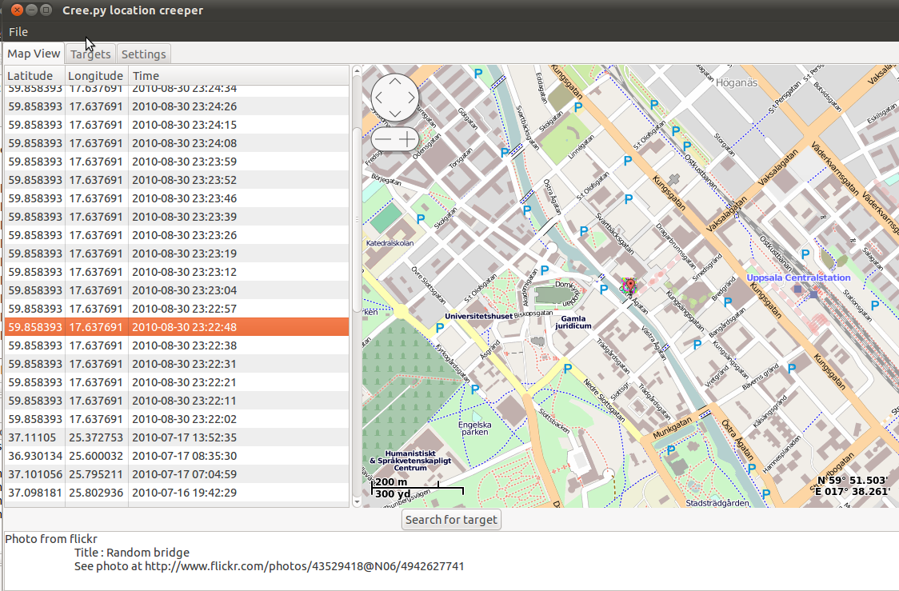
Others
www.geocreepy.com
www.datasploit.info

Slide 50
Perspectives
Attacker Perspective
1. Answer as many questions about your target or potential targets prior to directly touching or attacking their systems
2. Identify network information to be used in the next phase of the attack methodology (scanning)
3. Identify version information of applications and systems to use in phase 3 of the attack methodology (vulnerability identification)
4. Increase threat vector capability with social engineering attacks based on data found
…LEARN…

Slide 51
Perspectives
Defender Perspective
1. Discover what the internet knows about your infrastructure, and react appropriately
2. Ensure critical registration information is accurate and hasn’t been tampered with
3. Know what parts of your network are publicly facing and searchable
4. Find information about your network/company that may pose a threat
…VERIFY…

Slide 52
Perspectives
Investigator Perspective
1. Lookup network information as the internet knows it to compare with “known good” configurations
2. Keep an eye out for bragging or stolen information to show up on the web + social networking sites
…COMPARE…

Slide 53
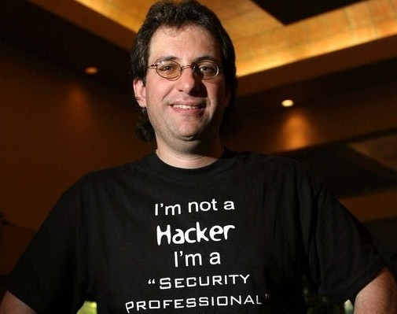
Summary
What is Reconnaissance
Performing preliminary research on target
Low Tech Recon
Visiting/Breaking In
Dumpster Diving
Social Engineering
Tech Recon
Social Engineering
Registration Info
OSINT
Shodan
Bing
Google
Google Hacking

Slide 54
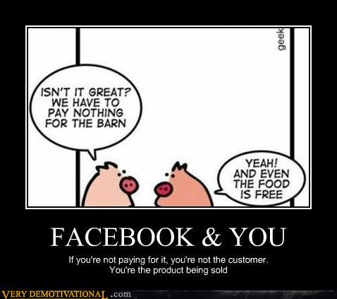
Summary
What is Social Media?
Social Networking Sites
Communications/Email
Collaboration/Authoring
Multimedia
Review
Social Media Data Mining
The Harvester
Recon-ng
Spiderfoot

Slide 55
Lab

